Slide 1
Diagramas UML Medieval Battles
José Renato Vicente 155984
Felipe Bueno Moret 155297

Slide 2
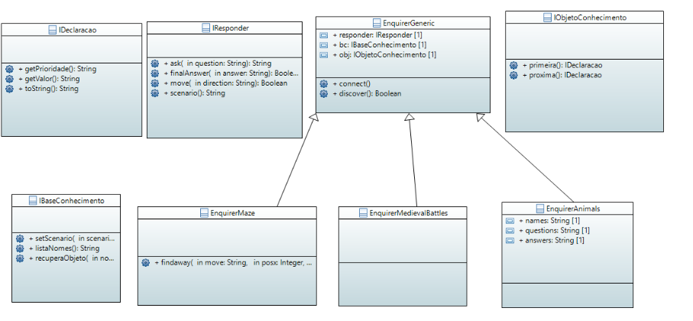

Slide 3
